Slide 1

Social Media Project
Topic : Wikipedia
Ngadi Bilal MOKRANE NaïM
ASENCIo Louis
Oheix Romain

Slide 2

Data presentation
The Wikipedia voting network is based on data from all administrator elections up until January 2008. It includes 2,794 elections, with 103,663 total votes and 7,066 users participating. Of these elections, 1,235 led to successful promotions, while 1,559 did not. The dataset consists of votes from both administrators and regular users. In the network, nodes represent Wikipedia users, and directed edges indicate a vote from one user to another.
The Wikipedia voting network consists of 7,115 nodes and 103,689 edges. This shows that it is a relatively large network, involving a large number of voting interactions between platform

Slide 3
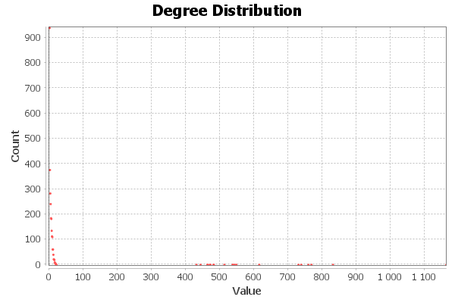
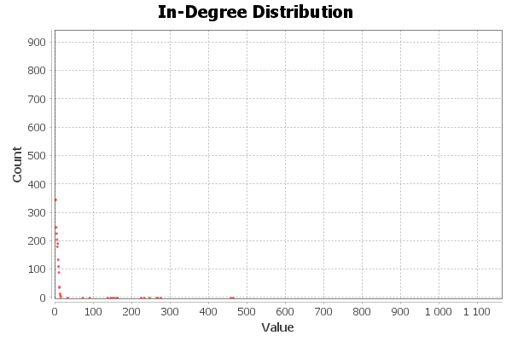
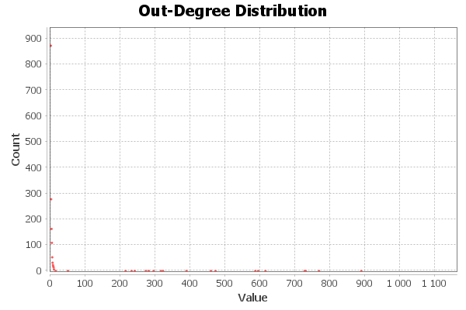
in-degree, out-degree
Most nodes have low degrees, meaning they either don't receive many incoming connections or don't initiate many outgoing connections.
This characteristic is typical of scale-free networks, where a few nodes act as highly connected hubs, and the majority of nodes are sparsely connected.
The distribution indicates that few nodes receive a large number of incoming connections (influencers, central nodes), while most nodes have very few incoming connections.
This suggests that the network might be influenced by a small number of highly popular or central nodes.
This pattern is typical in systems with a centralized influence, such as voting systems, where most of the activity or influence is focused around a few key players.
Similar to the in-degree distribution, there are a few nodes with many outgoing connections, while the majority of nodes have only a few outgoing connections or none at all.
This could mean that some nodes are active in spreading influence to others, while most nodes are passive receivers.

Slide 4
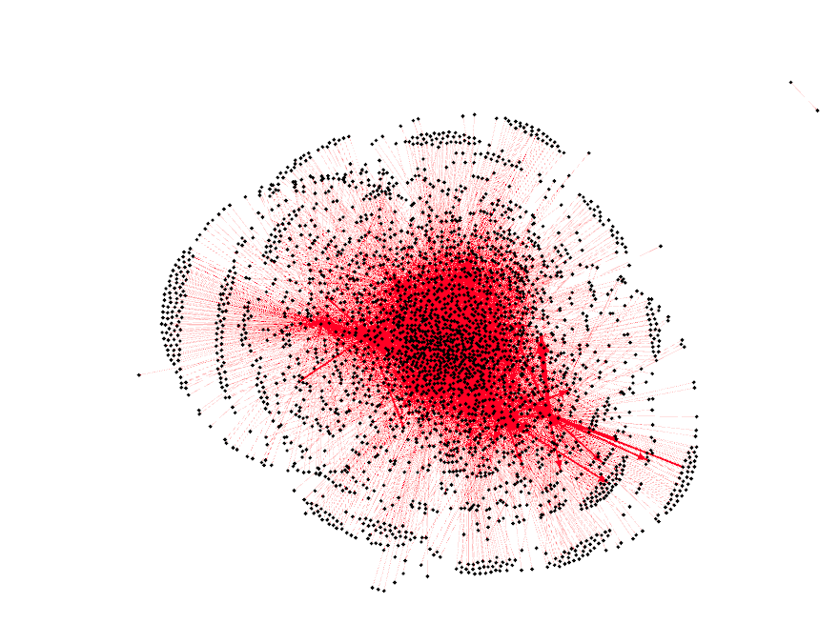
GePHY visualizations
The red concentration in the center indicates a core group of highly connected nodes. These nodes are likely the most active in the network and may be the central figures in a voting or decision-making process.
The peripheral nodes that are sparsely connected to the center likely have a smaller role or influence within the network.
Nodes at the center of the graph are well-connected, likely with high in-degrees and out-degrees. This means they either receive a lot of input or they actively influence other nodes.
The nodes located on the outer ring are more sparsely connected, likely with lower degrees. These nodes may be inactive or marginal participants in the overall dynamics of the network.
The nodes linking the dense core to the more peripheral sections might serve as bridge nodes, connecting otherwise disconnected parts of the network. These nodes help maintain the flow of influence and connections between different components.
The centrality of the red cluster likely indicates that a small number of nodes play a significant role in controlling or directing the flow of information or influence across the network. This is typical in voting networks, where a few key players dominate decision-making.

Slide 5
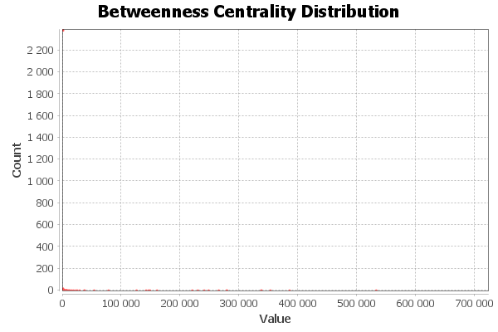
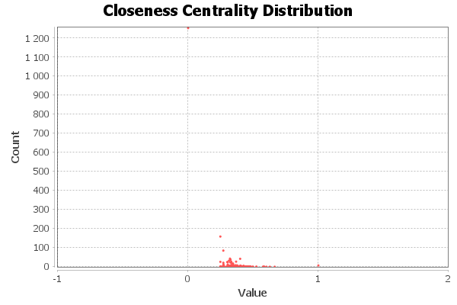
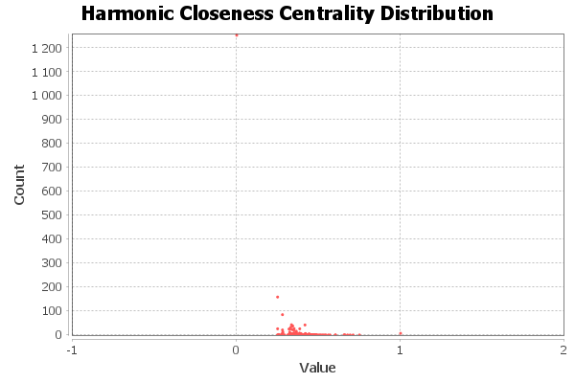
Diameter
Betweenness centrality measures the number of shortest paths that pass through a node. In the graph, we see that most nodes have very low betweenness centrality, with only a few nodes having higher values.
The distribution shows a few highly central nodes that play critical roles in connecting different parts of the network. These nodes act as bridges and are important for maintaining communication and interaction across the network.
Closeness centrality reflects how close a node is to all other nodes in the network, meaning the average shortest path length to all other nodes.
The graph indicates that most nodes have low or near-zero closeness centrality, with only a few nodes close to 1 or slightly above.
The majority of nodes are not central in terms of proximity to others, while a few nodes are well-positioned in terms of communication (closer to other nodes, reducing the number of steps to reach any node).
Harmonic closeness centrality is a variant that emphasizes closer nodes more, penalizing those that are farther away. It works similarly to closeness centrality but adjusts for the network’s structure.
Similar to the closeness centrality distribution, it shows that most nodes have low harmonic closeness centrality, and a few have high values.
This reinforces the idea that a small subset of nodes is positioned in the center of the network, ensuring better access to other nodes.
The diameter of a network is the longest shortest path between any two nodes. We have a diameter of 5, which means that the farthest distance between two nodes in the network is 5 steps.

Slide 6
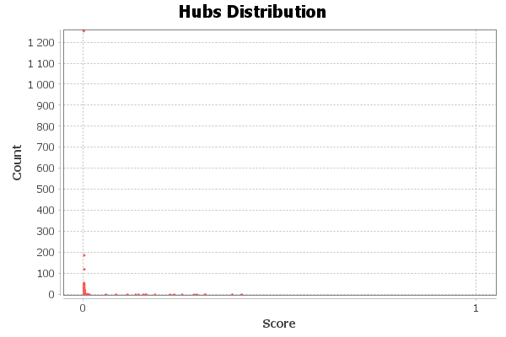
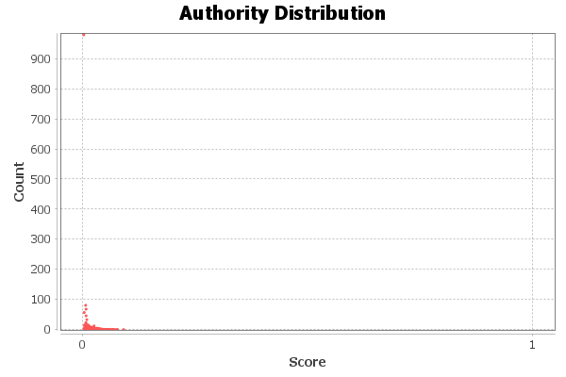
Hyperlink-Induced Topic Search (HITS)
The Hubs Distribution graph shows a very skewed distribution, with most nodes having a score close to 0 (indicating they are not hubs), while a small number of nodes have higher scores.
The majority of the nodes in the network have very low hub scores, suggesting they are not highly influential in terms of pointing to other nodes.
Only a few nodes are significant hubs, with higher scores (close to 1), meaning these nodes are central in terms of directing or linking to other nodes.
The small number of high hubs indicates that the network is likely centralized around a few influential nodes that connect many others. These high hub nodes may play a critical role in directing the flow of information, influence, or connections.
The majority of nodes are peripheral, having limited influence on connecting to other nodes, which is consistent with the previously observed degree distribution.

